Slide 1


The Fine Tuners (Team1)
31.10.2023

Slide 2
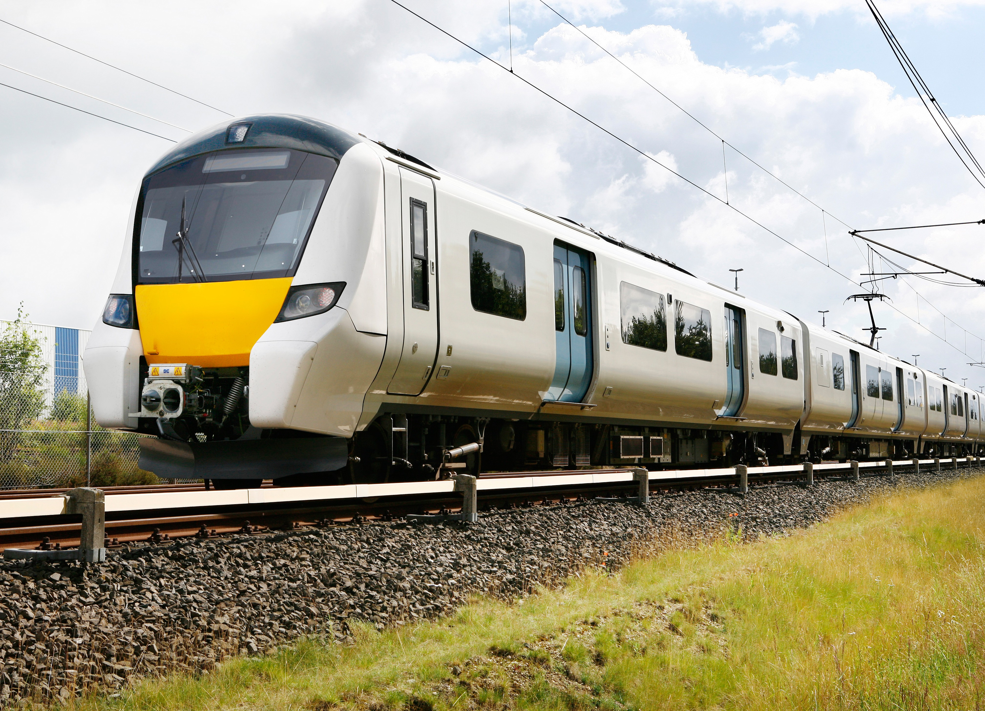
Enhancing Train Maintenance with NLP Analysis of Social Media Tweets
Presented by
Akshay Rajesh

Slide 3

Table of Content
Business Introduction
01
02
Requirements
MVP
03
04
Architecture
Product alignment with Business
05
06
Stakeholders
Risk Analysis
07
08
Performance Metrices
Summary
09
10
Next Steps

Slide 4

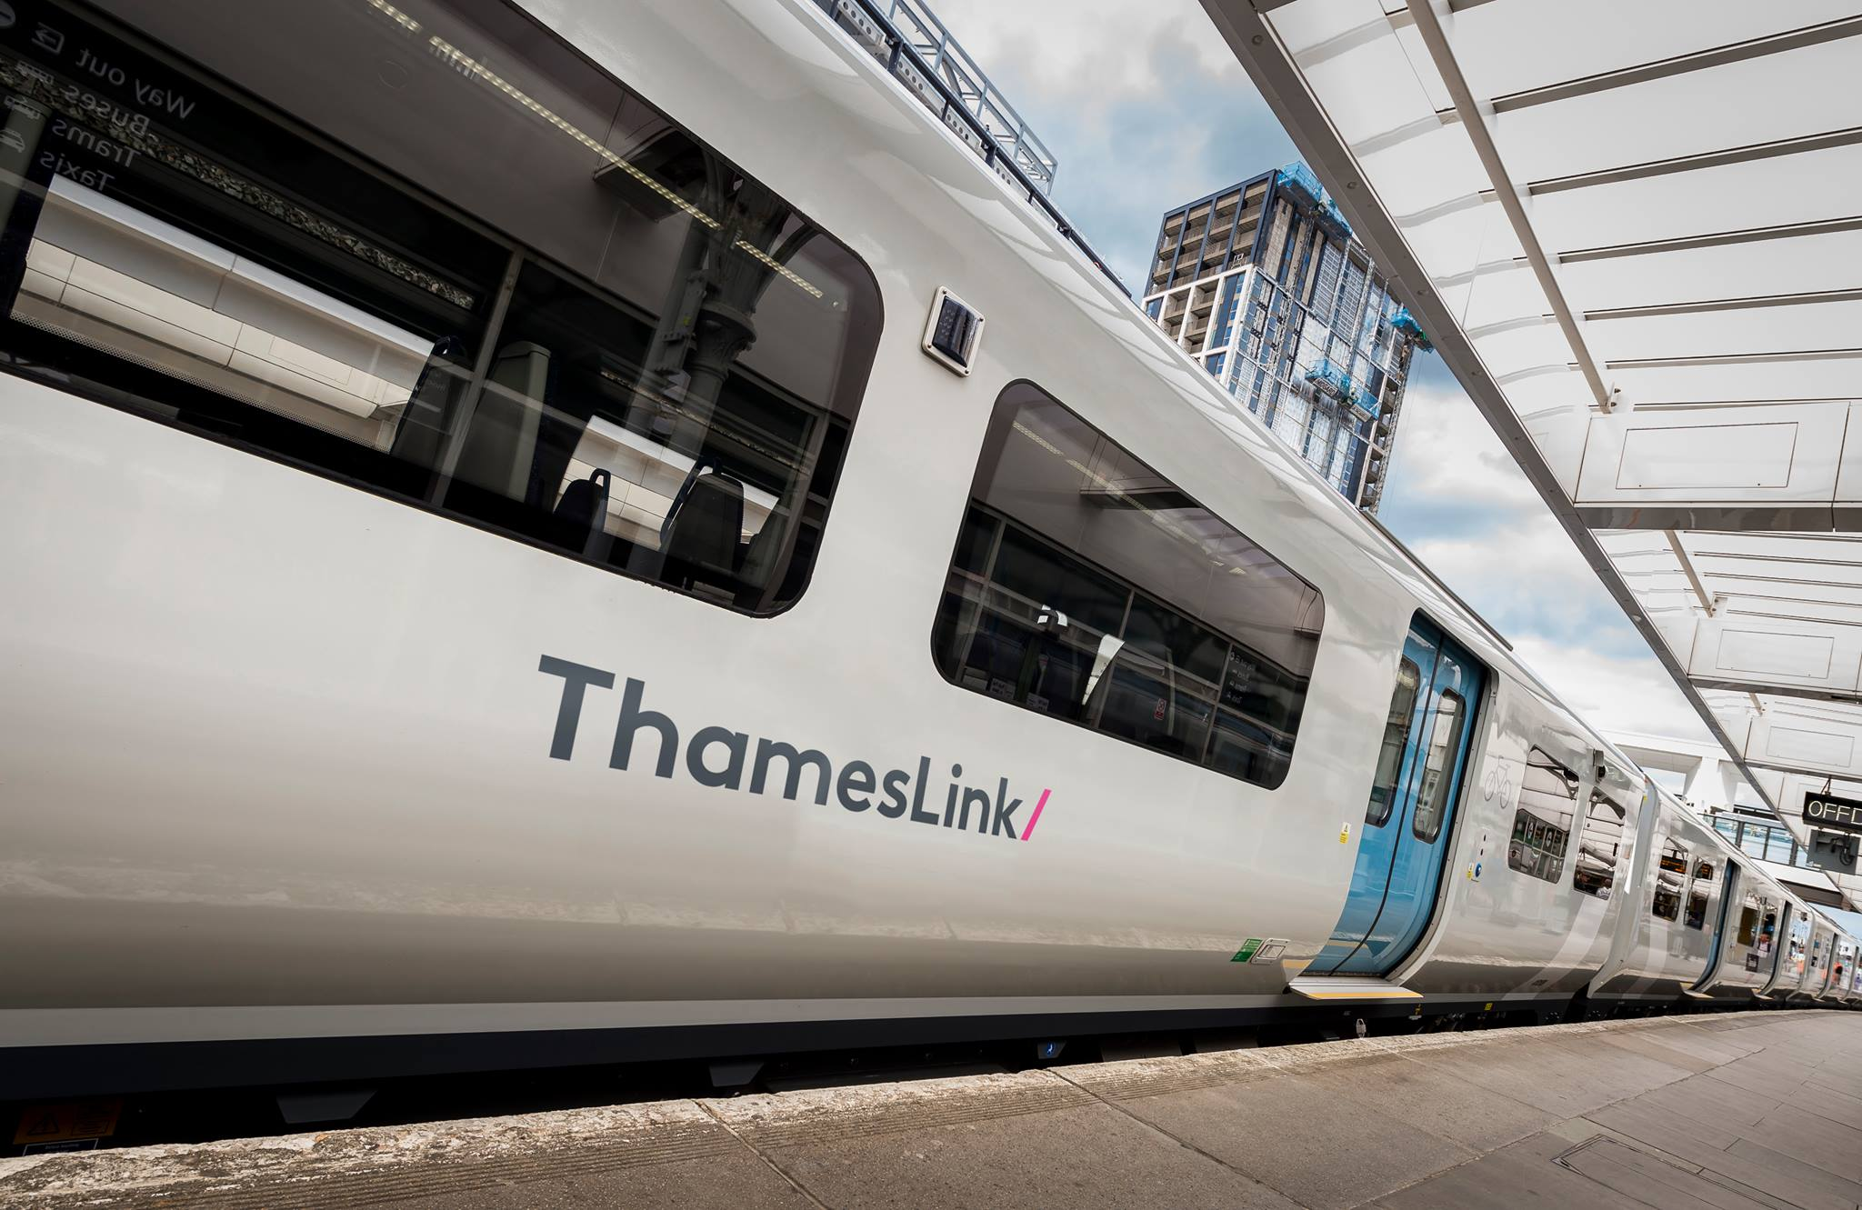
Introduction
Established in 1988 -24-hour mainline rail service
The Thameslink network includes services between Bedford and Brighton, passing through London,Luton Airport and stations to Wimbledon, Sutton and Sevenoaks
Dedicated to providing reliable and seamless journeys by Modernizing services
Improving stations -Ensuring passenger safety

Slide 5
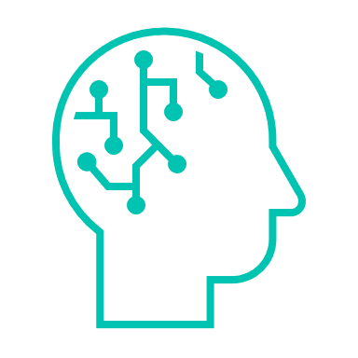

Business requirements
Enhancing Maintenance Through NLP and LLM
Objective: Using NLP and LLM to automatically derive actionable recommendations from social media tweets.
Outcome: Improved maintenance process , quick resolution and overall improving user satisfaction.

Slide 6
Our Mission, Approach and Goal
Apply advanced NLP techniques - classification, model tuning, prompt engineering - to autonomously generate actionable maintenance recommendations from tweet data.
Our Mission
Our Goal
Develop a robust system providing precise, real-time maintenance guidance based on social media data. This will lead to a improved operational efficiency at Thameslink.
Analyse social media tweets using NLP and GPT models to improve the maintenance operations at Thameslink.
Our Approach

Slide 7
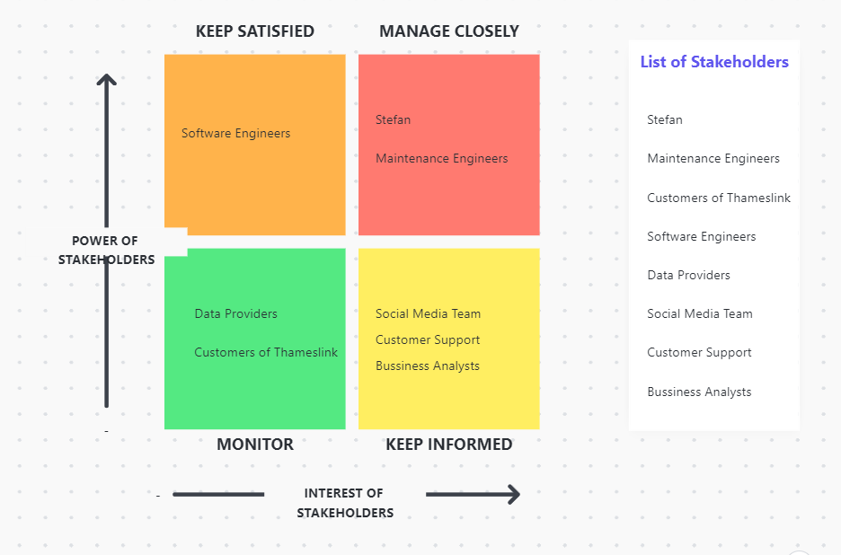
Stakeholder Analysis

Slide 8
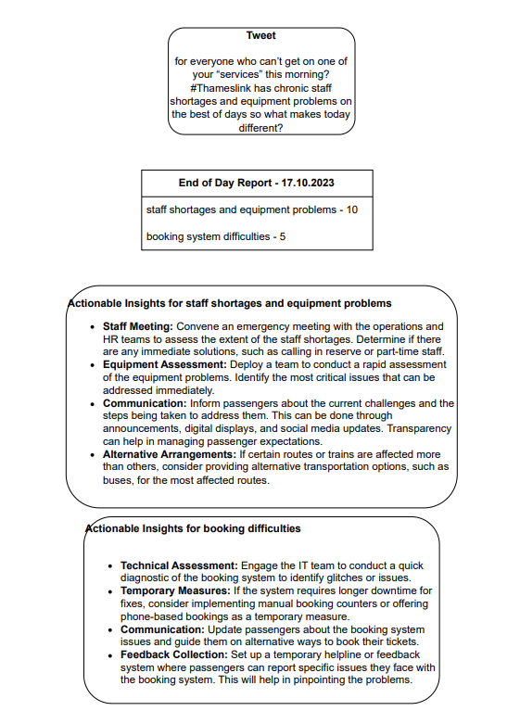





Product Vision -MVP
Tool Functionality: NLP analysis of social media tweets.
Benefits: Enhanced maintenance, improved passenger satisfaction, safety, and reliability.
Features: Issue identification, actionable recommendations.
Data Insights: Valuable insights from passenger feedback.
Results: Improved service quality demonstrated through case studies or statistics.

Slide 9
Architectural Overview
Tweet
LLM-Analysis
Complaint
LLM Suggestions
Tweet Processing
Classification Model
Analyse common complaints
Actionable Insights
Non-Complaint
Tweet Manual Labelling
Daily Reports

Slide 10


Product Alignment with Business
Enhanced Maintenance Operations which improves Safety and Reliability.
Data-Driven Decision-Making for Continuous Improvement .
Operational Efficiency and Proactive Issue Resolution .
Customer-Centric Approach .
Notes:
The product, which is the integration of NLP (Natural Language Processing) and ChatGPT into Thameslink's rail services, ties into the customer's (Thameslink's) business processes in several ways:
Enhanced Maintenance Operations:
The primary objective of implementing NLP and ChatGPT is to improve maintenance operations within Thameslink's rail services.
By analyzing social media tweets, the product can automatically derive actionable recommendations related to maintenance and safety. This directly impacts how Thameslink ensures the reliability and safety of its rail services.
Data-Driven Decision-Making:
The product facilitates data-driven decision-making within Thameslink's business processes. It enables the organization to harness the vast amount of data available on social media platforms and turn it into valuable insights.
Data analysis using NLP and ChatGPT allows Thameslink to identify trends, issues, and potential maintenance requirements.
Operational Efficiency:
Integration of NLP and ChatGPT streamlines the process of monitoring and responding to maintenance-related concerns.
The automation of recommendations from social media data reduces manual effort, making the maintenance process more efficient and responsive.
Proactive Issue Resolution:
By automatically deriving actionable recommendations, Thameslink can take a proactive approach to issue resolution.
This proactive stance allows the organization to address potential problems before they escalate, contributing to a smoother and more reliable service for customers.
Customer-Centric Approach:
Using NLP and ChatGPT to analyze social media data aligns with a customer-centric approach. Thameslink can identify and address concerns and feedback shared by passengers on social media promptly.
This approach demonstrates a commitment to improving the customer experience.
Safety and Reliability:
Ultimately, the product ties into the customer's business processes by enhancing safety and reliability, which are paramount in the rail service industry.
The actionable insights derived from social media data can help prevent safety issues and maintain the highest level of service reliability.
Continuous Improvement:
The integration of advanced technology fosters a culture of continuous improvement within Thameslink.
The organization can continuously refine its maintenance processes based on the recommendations generated by NLP and ChatGPT, resulting in an evolving and more efficient operation.
In conclusion, the product's integration of NLP and ChatGPT into Thameslink's business processes directly impacts maintenance, safety, and reliability. It enables data-driven decision-making, operational efficiency, and a customer-centric approach. This not only enhances the customer experience but also ensures that Thameslink continues to meet and exceed industry standards in rail service.

Slide 11
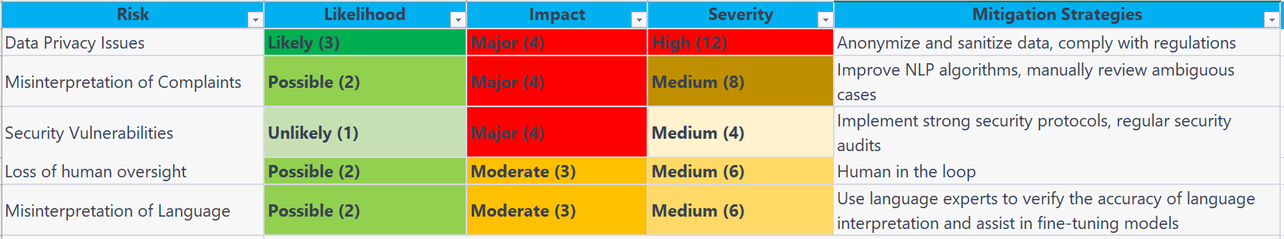
Risk Analysis
"The bandage was wound around the wound.“
"I've had delays on the Thameslink route three times this month! It's always a mess. #ThameslinkFail"
"@ThameslinkRail, the train ride was a roller coaster today! 🎢😬 #Thameslink #Excitement“
"Thanks @ThameslinkRail for the 'express' service today. We only made five unscheduled stops and arrived just 30 minutes late! Truly, you're the epitome of efficiency. 🙄🚂
Notes:
Data Privacy and Compliance:
Analyzing social media data involves handling personal information. Thameslink must be diligent in adhering to data protection regulations, such as GDPR in Europe, to protect the privacy of individuals. Mishandling of data could lead to legal consequences.
Data Accuracy and Noise:
Social media data may contain inaccuracies, misleading information, or even malicious content. Relying solely on such data for maintenance decisions can introduce errors and result in inappropriate actions.
Bias in Data:
Social media data may be biased or skewed based on the demographics of users and their online behavior. This bias can lead to skewed recommendations that don't represent the entire passenger base.
Misinterpretation of Language:
Language is nuanced, and AI systems can misinterpret the context or tone of social media posts. This may lead to inappropriate responses or actions, impacting customer relations.
Cybersecurity:
As Thameslink integrates AI and data analysis into its systems, it becomes more vulnerable to cyberattacks. Protecting against data breaches, system vulnerabilities, and ensuring data security is paramount.
Loss of Human Oversight:
Overreliance on automated NLP and ChatGPT systems without human oversight can lead to poor decision-making in critical situations. There should always be a human in the loop to validate and override recommendations when necessary.
Costs and ROI:
The implementation and maintenance of NLP and ChatGPT systems can be costly. It's essential to assess whether the benefits, such as improved maintenance and safety, outweigh these costs.
Customer Perception:
If not properly executed, the use of AI in analyzing social media data can be perceived as invasive or insincere. It's crucial to communicate transparently with customers about how their feedback is being used.
Limited Coverage:
Social media data may not represent the full spectrum of passenger feedback. It may not capture the opinions of passengers who don't use social media or who use other channels to communicate issues.
To mitigate these risks, Thameslink should invest in robust data governance, regularly assess the accuracy and fairness of its NLP models, and ensure strong cybersecurity measures. Additionally, a strong focus on ethical AI practices and clear communication with passengers about how their data is used can help build trust and minimize potential risks. Continuous monitoring and adaptation of the system are also crucial to address emerging challenges and maintain the safety and reliability of rail services.

Slide 12




Performance Metrics
Maintenance Issue Resolution Time:
Maintenance Cost Savings:
Customer Satisfaction:
Cost of Implementation vs. Benefits:
Notes:
Maintenance Issue Resolution Time:
Measure the average time it takes to resolve maintenance issues. This KPI helps assess the efficiency of your tool in identifying and addressing problems.
Formula: Total time to resolve maintenance issues / Number of resolved issues.
Set a target time frame for resolution and regularly track progress toward meeting that goal.
Maintenance Cost Savings:
Calculate the cost savings achieved through the use of your tool compared to a baseline scenario without the tool.
Formula: Baseline maintenance cost - Maintenance cost with the tool.
Periodically review and update this calculation as maintenance operations evolve.
Maintenance Issue Prevention:
Measure the reduction in the frequency and severity of maintenance issues. This can be assessed by comparing historical data before and after implementing your tool.
Track a decrease in the number of reported issues and analyze their impact on maintenance work.
Customer Satisfaction:
Gather feedback from passengers through surveys or sentiment analysis of social media posts.
Monitor the sentiment and feedback provided by passengers, and regularly assess changes in customer satisfaction scores.
Implement NPS (Net Promoter Score) or CSAT (Customer Satisfaction Score) surveys to quantify customer satisfaction levels.
Response Time to Social Media Posts:
Calculate the average time it takes to respond to social media posts, both positive and negative. This reflects the organization's ability to engage with passengers.
Formula: Total response time for all posts / Number of posts.
Establish response time benchmarks based on industry standards and passenger expectations.
Cost of Implementation vs. Benefits:
Measure the return on investment (ROI) by comparing the initial implementation cost to the benefits gained, such as cost savings and improved customer satisfaction.
Formula: (Benefits - Implementation Cost) / Implementation Cost.
Regularly reassess this KPI as the tool's benefits and costs evolve.

Slide 13
Summary
Who is the company and what is the service provided .
Mission and Vison for the project .
Architecture of the MVP explained .
Identified and categorised the stakeholders.
Analysed the Risks for the project .
KPI‘s for meauring the bussiness improvement is identified .

Slide 14
Next Steps
Data understanding and initial EDA .
Understanding the quality of existing lables by manually classifying tweets .
Start with data preprocessing – stemming , lementization , entity extraction etc .
Take a pretrained classification model and finetune to get the complaints and non complaints.
Feed the tweets to chatgpt or any LLM model to get actions to fix the issue .

Slide 15
Thank you!

